Slide 1
Spring Boot Framework
Day 1

Slide 2

What is Spring Boot Framework?
Spring Boot makes it easy to create stand-alone, production-grade Spring based Applications. It’s a Java-based framework.
It offers several plug-ins.
It provides production-ready features such as metrics, health checks, and externalized configuration.
There is no requirement for XML configuration.

Slide 3
All kinds of applications can be designed using spring boot.
For web applications, spring boot provides in built web servers (tomcat).
Many things are auto-configured.
Each application can have its own server.

Slide 4
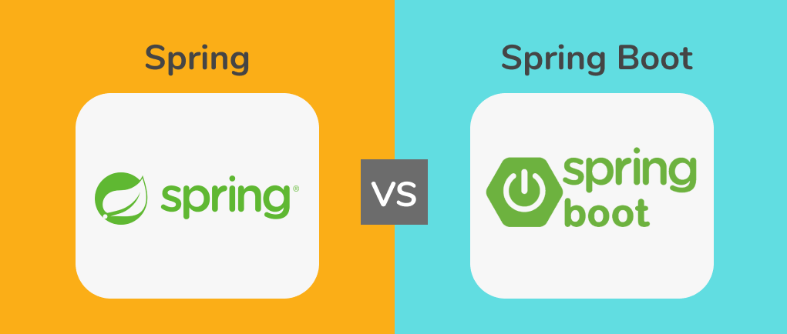

Slide 6
Spring | Spring Boot
Spring framework is a java EE framework that is used to build applications. | Spring Boot framework is mainly used to develop REST API’s
Its goal is to make Java EE (Enterprise Edition) development easier, allowing developers to be more productive. | Spring Boot provides the RAD(Rapid Application Development) feature to the Spring framework for faster application development.
Spring framework helps to create a loosely coupled application. | Spring Boot helps to create a stand-alone application.
In the Spring framework to test the Spring Project, we need to set up the servers explicitly. | Spring Boot offers built-in or embedded servers such as Tomcat and jetty.

Slide 7
Why we are using Spring Boot Framework?
The dependency injection approach is used in Spring Boot.
It contains powerful database transaction management capabilities.
It simplifies integration with other Java frameworks like JPA/Hibernate ORM, Struts, etc.
It reduces the cost and development time of the application.

Slide 8
Prerequisite of Spring Boot
Spring Tool Suite (STS) or Eclipse or Intelij IDE
Java 1.8
Spring Boot version 3.0
PostgreSQL

Slide 9
Spring Boot Framework
Day 2

Slide 10
Spring Boot Features :
Web Development
Spring Application
Properties Files
YAML Support
Logging
Security

Slide 11
Web Development :
Spring Boot is great for building web applications.
we can easily create an HTTP application with built-in servers like Tomcat, Jetty, or Undertow.
Use the spring-boot-starter-web module to start and run your application quickly.

Slide 12
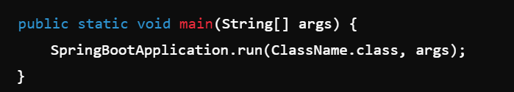
Spring Boot Application :
The Spring Boot Application class makes it easy to start a Spring application.
we can start the application from the main method using a static run() method.

Slide 13
Properties Files :
Spring Boot offers many application properties.
we can use those properties in our project's properties file.
The properties file lets you set configurations like server-port=8082.
It helps organize and manage application settings.

Slide 14
YAML Support :
It provides a convenient way of specifying the hierarchical configuration.
It is a superset of JSON.
The SpringBootApplication class automatically supports YAML.
It is an alternative to the properties file.

Slide 15
Logging :
Spring Boot uses Common Logging for its internal logs.
Logging dependencies are managed automatically.
Avoid changing logging dependencies unless customization is required.

Slide 16
Security :
Spring Boot applications are spring-based web applications.
So, it is secure by default with basic authentication on all HTTP endpoints.
A rich set of Endpoints is available to develop a secure Spring Boot application.

Slide 17
Spring Boot Framework
Day 3

Slide 18
Spring Boot Architecture

Slide 19
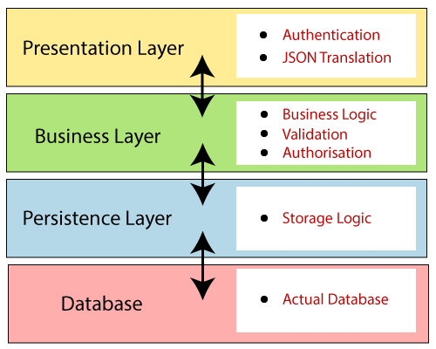
There are four layers in Spring Boot are as follows:
Presentation Layer
Business Layer
Persistence Layer
Database Layer

Slide 20
Presentation Layer:
The presentation layer handles the HTTP requests, translates the JSON parameter to an object, authenticates the request, and transfers it to the business layer.
In short, it consists of views i.e., the frontend part.
Business Layer:
The business layer handles all the business logic.
It consists of service classes and uses services provided by data access layers.
It also performs authorization and validation.

Slide 21
Persistence Layer:
The persistence layer contains all the storage logic
It translates business objects to and from database rows.
Database Layer:
In the database layer, CRUD (create, retrieve, update, delete) operations are performed.

Slide 22

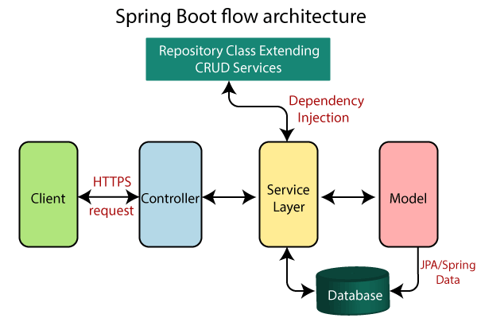

Slide 23
The architecture of Spring Boot is similar to Spring MVC, but there is no need for DAO and DAOImpl classes.
It creates a data access layer and performs CRUD operations.
The client makes HTTP requests (PUT or GET).
The request goes to the controller, which maps and handles it, calling the service logic if needed.
The service layer performs all business logic on the data, which is mapped to JPA with model classes.

Slide 24
Spring Boot Framework
Day 4

Slide 25
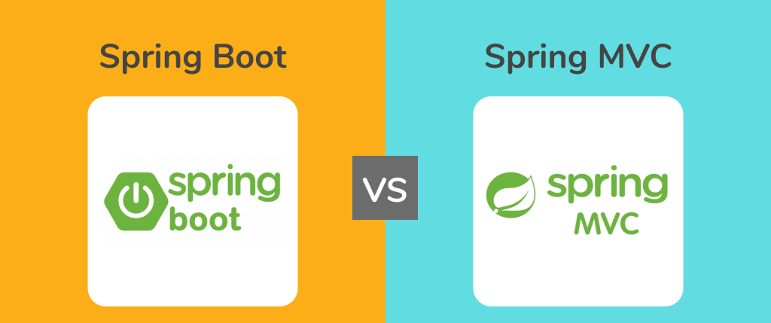

Slide 26
What is Spring MVC?
Spring MVC is a Java framework used to build web-based applications.
So, Spring MVC is an integrated version of the Spring framework and Model View Controller.
It has all the basic features of the core Spring framework like Dependency Injection and Inversion of Control.
The MVC pattern segregates the application’s different aspects (input logic, business logic, and UI logic) while providing a loose coupling between these elements.

Slide 27
The Model contains the core data of the application. In general, they consist of POJO (Plain Old Java Object).
The View is responsible for rendering the model’s data, and it generates HTML output that the client’s browser can interpret.
The Controller contains the business logic of the application.
Spring MVC is built around the Dispatcher Template that handles the HTTP requests and responses.

Slide 28
How does Spring MVC Works?
The client system sends an HTTP request to a specific URL.
Dispatcher Servlet, configured in the web.xml file, receives the request.
It then passes the request to a specific controller by finding it using Handler Mapping depending on the URL requested using @RequestMapping and @Controller annotations.
Spring MVC Controller executes the business logic and then returns a logical view name and model to Dispatcher Servlet.

Slide 29
The Dispatcher Servlet finds the right view (like Excel, Freemarker, JSP) to use based on configured rules.
Finally, this formatted output is sent back to the client as a response.

Slide 30
What is Spring Boot?
Spring Boot is another popular Java framework used for building applications.
It mainly focuses on creating standalone applications.
It is an extended version of the Spring framework that helps to reduce the development time.
Spring Boot is great for enterprise applications
There are four layers in Spring boot;
Presentation layer
Business layer
Persistence layer
Database layer

Slide 31
The workflow goes like:
The client makes the HTTP requests.
This request goes to the controller, and the controller maps and handles it.
The request is passed on to the service layer where all the business logic is performed on the data that is mapped to JPA with model classes.
As a result, a response is returned to the user if no error occurred.

Slide 32
Spring Boot Framework
Day 5

Slide 33
How to create Spring Boot Application
&
Spring boot Annotations

Slide 34
Spring Initializer
Spring Boot STS IDE
Spring Boot CLI

Slide 35
@Bean:
Indicates that a method produces a bean to be managed by the Spring container.
@Bean
public PasswordEncoder passwordEncoder(){
return new BCryptPasswordEncoder(); //BCryptPasswordEncoder function provided by the spring security
}

Slide 36
@SpringBootApplication
A single @SpringBootApplication annotation is used to enable the following annotations:
@EnableAutoConfiguration: It enables the Spring Boot auto-configuration mechanism.
@ComponentScan: It scans the package where the application is located.
@Configuration: It allows us to register extra beans in the context or import additional configuration classes.

Slide 37
@Required: It applies to the bean setter method.
It indicates that the annotated bean must be populated at configuration time with the required property, else it throws an exception BeanInitilizationException.
public class Machine
{
private Integer cost;
@Required
public void setCost(Integer cost)
{
this. cost = cost;
}
public Integer getCost()
{
return cost;
}
}

Slide 38
@Component:
It is a class-level annotation.
Turns the class into a spring bean at the auto-scan time.
@Component
public class Student
{
.......
}

Slide 39
@Autowired :
Injecting the application parts together, on the fields, constructors, or methods in a component.
@Component
public class Customer
{
private Person person;
@Autowired
public Customer(Person person)
{
this.person=person;
}
}

Slide 40
@Controller: The @Controller is a class-level annotation.
The @Controller annotation is a special type of @Component that is used to handle web requests and show web pages.
It is mostly used with @RequestMapping annotation.
@Controller
@RequestMapping("books")
public class BooksController
{
@RequestMapping(value = "/{name}", method = RequestMethod.GET)
public Employee getBooksByName()
{
return booksTemplate;
}
}

Slide 41
@Service:
It is also used at the class level. It tells the Spring that the class contains the business logic.
package com.java;
@Service
public class TestService
{
public void service1()
{
//business code
}

Slide 42
@Repository:
The repository is a DAOs (Data Access Object) that access the database directly.
The repository does all the operations related to the database.
package com.java;
@Repository
public class TestRepository
{
public void delete()
{
//persistence code
}
}

Slide 43
@RequestMapping: It is used to map web requests.
It has many optional elements like consumes, header, method, name, params, path, produces, and value.
We use it with the class as well as the method.
@Controller
public class BooksController
{
@RequestMapping("/computer-science/books")
public String getAllBooks(Model model)
{
//application code
return "bookList";
}

Slide 44
@GetMapping: It maps the HTTP GET requests on the specific handler method. It is used to create a web service endpoint that fetches It is used instead of using: @RequestMapping(method = RequestMethod.GET)
@PostMapping: It maps the HTTP POST requests on the specific handler method. It is used to create a web service endpoint that creates It is used instead of using: @RequestMapping(method = RequestMethod.POST)
@PutMapping: It maps the HTTP PUT requests on the specific handler method. It is used to create a web service endpoint that creates or updates It is used instead of using: @RequestMapping(method = RequestMethod.PUT)

Slide 45
@DeleteMapping:
It maps the HTTP DELETE requests on the specific handler method.
It is used to create a web service endpoint that deletes a resource.
It is used instead of using: @RequestMapping(method = RequestMethod.DELETE)
@RequestBody:
It is used to bind HTTP requests with an object in a method parameter.
Internally it uses HTTP Message Converters to convert the body of the request.
When we annotate a method parameter with @RequestBody,
The Spring framework binds the incoming HTTP request body to that parameter.

Slide 46
@ResponseBody: It tells the Spring Boot Framework to serialize a return an object into JSON and XML format.
@PathVariable: It is used to extract the values from the URI. It is most suitable for the RESTful web service, where the URL contains a path variable. We can define multiple @PathVariable in a method.
@RestController:
It can be considered as a combination of @Controller and @ResponseBody annotations.
The @RestController annotation is itself annotated with the @ResponseBody annotation.
It eliminates the need for annotating each method with @ResponseBody.

Slide 47
Spring Boot Framework
Day 6

Slide 48
Spring Boot Application Properties:
Spring Boot Framework comes with a built-in mechanism for application configuration using a file called application.properties.
It is located inside the src/main/resources folder.
Spring Boot provides various properties that can be configured in the application.properties file.
The properties have default values. We can set a property(s) for the Spring Boot application.
Spring Boot also allows us to define our own property if required.

Slide 49
Example of application.properties
#configuring application name
spring.application.name = demoApplication
#configuring port
server.port = 8081

Slide 50
YAML Properties File
Spring Boot provides another file to configure the properties is called yml file.
The Yaml file works because the Snake YAML jar is present in the classpath.
Instead of using the application.properties file
we can also use the application.yml file, but the Yml file should be present in the classpath.

Slide 51
Example of application.yml
spring:
application:
name: demo Application
server:
port: 8081

Slide 52
Spring Boot Property Categories:
There are sixteen categories of Spring Boot Property are as follows:
Core Properties
Cache Properties
Mail Properties
JSON Properties
Data Properties
Transaction Properties
Data Migration Properties
Integration Properties
Web Properties
Templating Properties
Server Properties
Security Properties
RSocket Properties
Actuator Properties
DevTools Properties
Testing Properties

Slide 53
Spring Boot Framework
Day 7

Slide 54
Spring Boot Rest Concept

Slide 55
All kinds of applications can be designed using spring boot .
For web applications spring boot provides built in web servers (tomcat) .
Spring boot is openionated .
Many things are auto configured . Each application can have its own server

Slide 56
Rest : - Representational state transfer Data received from the server depends on URL.
URL represents a particular page Whenever we change URL display to a new page.
Data formats : XML format
JSON format

Slide 57
XML Format :
<employee>
<empId> 100 </empId>
<empName> 'saddam’ </empName>
</employee>
XML file is quite bulky that’s why using JSON

Slide 58
JSON Format : Java script object notation
Single Object : { "emp Id " : 10,"name" : " saddam " }
Multiple Object : [
{ "emp Id " : 10,"name" : " saddam " }
{ "emp Id " : 20,"name" : " Hussain " }
{ "emp Id " : 30,"name" : " Naveen " }
]

Slide 59
How to create spring boot rest application project ?
create spring boot starter project with following dependencies
spring web
dev tools

Slide 60
spring web is using means we are seeing the data in web pages based on URL
spring boot dev tools whenever makes the changes in code we can save the code that's it automatic restart the code without using the stopping process
This is the advantages of spring boot dev tool

Slide 61
Spring Boot Framework
Day 8

Slide 62
Basic Spring Boot Application creation
Video Link : https://youtu.be/domBd8sNowc

Slide 63
Spring Boot with Lombok Dependency Advantages
Video Link : https://youtu.be/sbnXhixqY3I

Slide 64
Difference between @Pathvariable and @RequestParam Annotations
Video Link : https://youtu.be/Ghd8llQ9mD8

Slide 65
Spring Boot Framework
Day 9

Slide 66
Spring Boot Data JPA

Slide 67
Create Entity classes with annotations
@Entity
@Id
@OneToOne
@OneToMany etc.,
we need to provide database details in application.properties file

Slide 68
Create repository interface and extending below interfaces.
Crud repository interface
Jpa repository interface(which provide all jpa methods)

Slide 69
Spring fox swagger
swagger is a documentation tool for rest application
swagger provides excellent UI for testing rest application spring boot does not provide swagger dependency

Slide 70
we need to add the swagger 2 and swagger dependencies
add @EnableSwagger2 annotation to the main class
with swagger we can test rest application using any normal browser

Slide 71
url's :
http://localhost:port number/v2/api-docs
http://localhost:port number/swagger-ui-html
We can use postman or swagger anything

Slide 72
Spring Boot Framework
Day 10

Slide 73
Spring Boot exception handling

Slide 74
@controllerAdvice :-
It is the class which handles all the Global exceptions in the application.
It can have methods to handle different exceptions.
When exception happen or occurs anywhere in the application controller advice is handling.
In controller advice class we need to write
@ExceptionHandler(Studentnotfoundexception.class) annotation in each method.

Slide 75
Spring Boot data validation

Slide 76
Spring data validation :-
check the data sent by the client.
Client sends the data in Json format.
Json is translated into Java object in the controller.
While translating we need to check the data.

Slide 77
Steps :-
add validation dependency.
use validation annotations in entity classes.
In the controller use @ valid annotation along with @RequestBody.
@Valid annotation makes it possible to check the validation errors.
If validation fails method argument not valid exception is thrown.
Controller advice should handle these exception

Slide 78
Exception Handling and Data validation
Video link : https://youtu.be/cPbNppp-9rs

Slide 79
Spring Boot Framework
Day 11

Slide 80
Spring Boot Starter Actuator

Slide 81
Spring Boot Actuator is a sub-project of the Spring Boot Framework.
It includes a number of additional features that help us to monitor and manage the Spring Boot application.
It contains the actuator endpoints (the place where the resources live).

Slide 82
We can use HTTP and JMX endpoints to manage and monitor the Spring Boot application.
If we want to get production-ready features in an application, we should use the Spring Boot actuator.
Spring Boot Actuator Features
There are three main features of Spring Boot Actuator:
Endpoints
Metrics
Audit

Slide 83
Endpoint:
The actuator endpoints allows us to monitor and interact with the application.
Spring Boot provides a number of built-in endpoints. We can also create our own endpoint.
We can enable and disable each endpoint individually.
Most of the application choose HTTP, where the Id of the endpoint, along with the prefix of /actuator, is mapped to a URL.
For example, the /health endpoint provides the basic health information of an application.
The actuator, by default, mapped it to /actuator/health.

Slide 84
Metrics:
Spring Boot Actuator provides dimensional metrics by integrating with the micrometer.
The micrometer is integrated into Spring Boot.
It is the instrumentation library powering the delivery of application metrics from Spring.
It provides vendor-neutral interfaces for timers, gauges, counters, distribution summaries, and long task timers with a dimensional data model.

Slide 85
Audit:
Spring Boot provides a flexible audit framework that publishes events to an AuditEventRepository.
It automatically publishes the authentication events if spring-security is in execution.

Slide 86
Enabling Spring Boot Actuator
We can enable actuator by injecting the dependency spring-boot-starter-actuator in the pom.xml file.
<dependency>
<groupId>org.springframework.boot</groupId>
<artifactId>spring-boot-starter-actuator</artifactId>
<version>2.2.2.RELEASE</version>
</dependency>

Slide 87
Id | Usage | Default
actuator | It provides a hypermedia-based discovery page for the other endpoints. It requires Spring HATEOAS to be on the classpath. | True
auditevents | It exposes audit events information for the current application. | True
autoconfig | It is used to display an auto-configuration report showing all auto-configuration candidates and the reason why they 'were' or 'were not' applied. | True
beans | It is used to display a complete list of all the Spring beans in your application. | True
configprops | It is used to display a collated list of all @ConfigurationProperties. | True
dump | It is used to perform a thread dump. | True
env | It is used to expose properties from Spring's ConfigurableEnvironment. | True
flyway | It is used to show any Flyway database migrations that have been applied. | True
health | It is used to show application health information. | False
info | It is used to display arbitrary application info. | False
loggers | It is used to show and modify the configuration of loggers in the application. | True
liquibase | It is used to show any Liquibase database migrations that have been applied. | True
metrics | It is used to show metrics information for the current application. | True
mappings | It is used to display a collated list of all @RequestMapping paths. | True
shutdown | It is used to allow the application to be gracefully shutdown. | True
trace | It is used to display trace information. | True

Slide 88
For Spring MVC, the following additional endpoints are used.
Id | Description | Default
docs | It is used to display documentation, including example requests and responses for the Actuator's endpoints. | False
heapdump | It is used to return a GZip compressed hprof heap dump file. | True
jolokia | It is used to expose JMX beans over HTTP (when Jolokia is on the classpath). | True
logfile | It is used to return the contents of the logfile. | True
prometheus | It is used to expose metrics in a format that can be scraped by a prometheus server. It requires a dependency on micrometer-registry- prometheus. | True

Slide 89
Spring Boot Framework
Day 12

Slide 90
Application . properties file
v/s
Application . yml file

Slide 91
Application . properties file :
Data is stored in key-value fashion.
Sequential format
Advantages :
Easy to modify
Disadvantages :
Repetition in keys
On increase in properties file, it becomes difficult to understand the keys and value.

Slide 92
Application . yml file :
Yml stands for yet another markup language.
Stores data in key-value pair fashion.
Hierarchical format.
Advantages :
Easy to modify.
Easy to understand as it follows hierarchical approach
No repetitions in keys.
Multi language support like java, python etc.,
We can have array, list, and map also in yaml.
Disadvantages :
Complex indentation formatting.

Slide 93
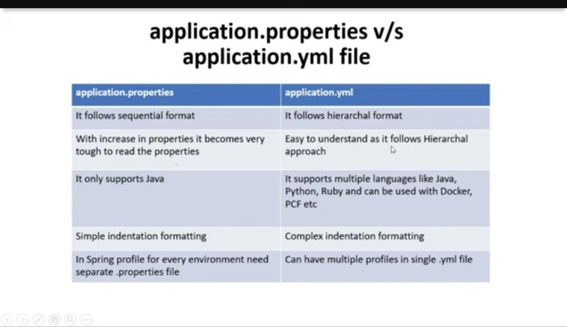

Slide 94
Spring Boot Framework
Day 13

Slide 95
@Qualifier vs @Primary Annotations with Examples

Slide 96
We can use @Qualifier and @Primary for the same bean.
Use @Qualifier to inject specific bean otherwise Spring injects bean by default which is annotated with @Primary

Slide 97
Let us create an interface University,
University.java
package com.easy;
public interface University {
public String display();
}

Slide 98
Now this university is implemented by couple of services, Alpha University and Beta University
AlphaUniversity.java
package com.easy.service;
import com.easy.University;
import org.springframework.stereotype.Service;
@Service
public class AlphaUniversity implements University {
@Override
public String display() {
return "This is a message from Alpha University";
}
}

Slide 99
BetaUniversity
package com.easy.service;
import com.easy.University;
import org.springframework.stereotype.Service;
@Service
public class BetaUniversity implements University {
@Override
public String display() {
return "This is a message from Beta University";
}
}

Slide 100
Now let us have a controller,
UniversityController.java
package com.easy.controller;
import com.easy.University;
import org.springframework.beans.factory.annotation.Autowired;
import org.springframework.web.bind.annotation.GetMapping;
import org.springframework.web.bind.annotation.RestController;
@RestController
public class UniversityController {
@Autowired
private University university;
@GetMapping ("/university")
public String getUniversity() {
return university.display();
}
}

Slide 101
Now when we call “/univeristy” API which dependency will be actually called?
will it be Alpha University or Beta University?

Slide 102
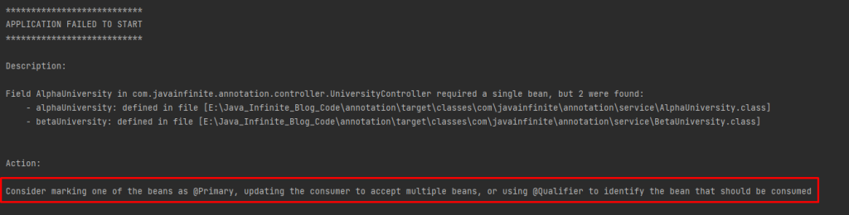

Slide 103
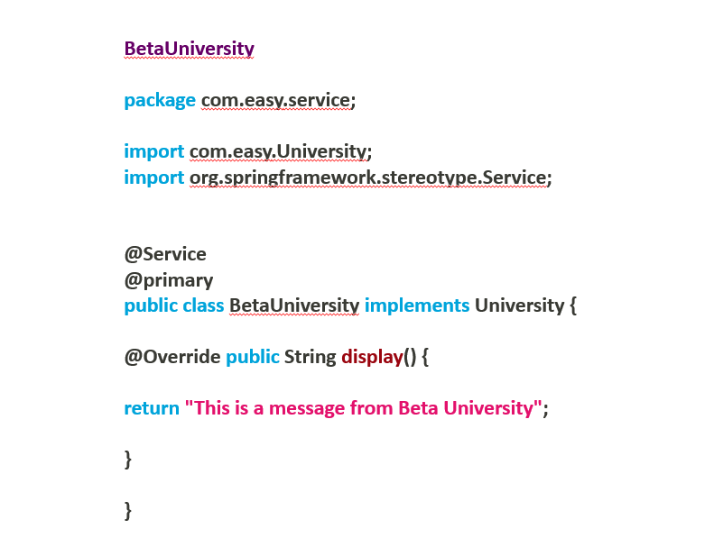

Slide 104
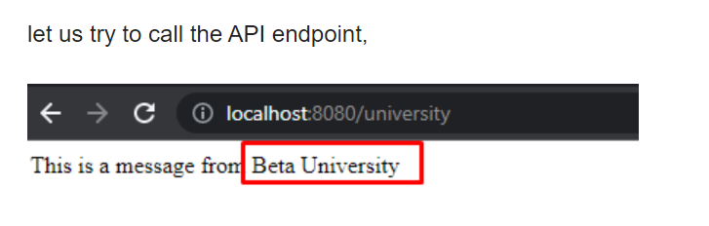

Slide 105
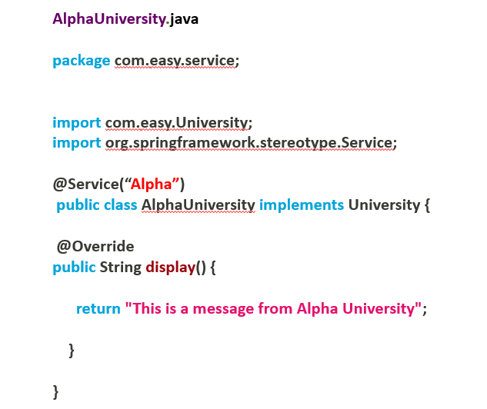
Spring boot has considered BetaUniversity as a preferred bean when University is Autowired.
Now let us use @Qualifier annotation to differentiate beans,

Slide 106
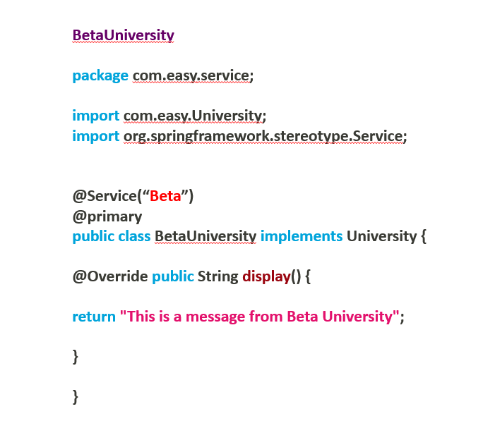

Slide 107
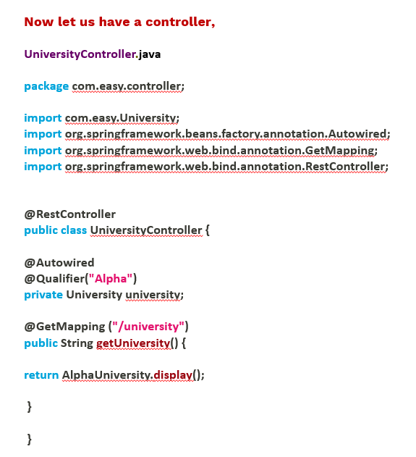

Slide 108
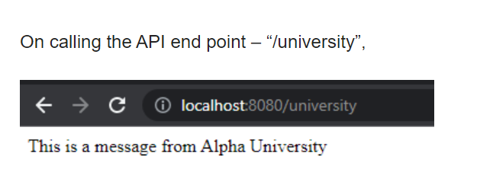

Slide 109
Which is of higher priority @Primary or @Qualifier?
@Qualifier has higher priority than @Primary annotation.
In the above example we have used both @Primary and @Qualifier together – Qualifier has taken higher priority than @Primary.
Can we declare both @Primary and @Qualifier together?
Yes, Both annotations can be used together but only one can be executed at a time. (Qualifier first, if qualifier not present it will execute primary)

Slide 110
Spring Boot Framework
Day 14

Slide 111
How to Use Profiles in Spring Boot?

Slide 112
What Are Profiles?
Every enterprise application has many environments, like:
Dev | Test | Acceptance | Production
Each environment needs its own specific settings. For example, in DEV, we don't need to check database consistency all the time.
But in Test and Acceptance, we do need to check it. These environments have specific configurations called Profiles.

Slide 113
How to Use Profiles in Spring Boot?
Video link : https://youtu.be/P4GPBpLhOug

Slide 114
Spring Boot Framework
Day 15

Slide 115
One-to-One Uni-directional
Mapping in Spring Boot

Slide 116
One-to-One Uni-directional Mapping
Table 1
Table 2
EmpId | EmpName | TaskId
1 | Naveen | 8
2 | Hussain | 7
TaskId | Task
7 | Login issues
8 | Registration issues

Slide 117
In JPA (Java Persistence API), a one-to-one unidirectional mapping means that there is a relationship between two entities.
Where one entity has a reference to another entity, but the reverse is not true.
This is a unidirectional relationship because only one entity has knowledge of the other entity, and there is no backward reference.
Example :
Let's consider an example with two entities: Employee and Task.
Employee has one Task reference task id, but the Task does not have a reference back to the Employee.

Slide 118
In JPA, the @GeneratedValue annotation is used to specify the primary key generation strategy for the @Id field.
The strategy element of the @GeneratedValue annotation determines how the primary key values are generated
The different generation strategies available in JPA:
@GeneratedValue(strategy = GenerationType.AUTO) @GeneratedValue(strategy = GenerationType.IDENTITY) @GeneratedValue(strategy = GenerationType.SEQUENCE, generator = "person_seq")
@SequenceGenerator(name = "person_seq", sequenceName = "person_sequence", allocationSize = 1) @GeneratedValue(strategy = GenerationType.TABLE, generator = "person_table_gen")
@TableGenerator(name = "person_table_gen", table = "id_gen", pkColumnName = "gen_name", valueColumnName = "gen_value", pkColumnValue = "person_id", allocationSize = 1)

Slide 119
GenerationType.AUTO
Description: The persistence provider (e.g., Hibernate) will automatically choose the generation strategy based on the underlying database.
Use Case: When you want the provider to decide the best generation strategy for the database.

Slide 120
GenerationType.IDENTITY
Description: The database generates the primary key values using an auto-increment column or a similar mechanism.
Use Case: Suitable for databases that support auto-increment fields (e.g., MySQL, PostgreSQL).

Slide 121
GenerationType.SEQUENCE
Description: Uses a database sequence object to generate primary key values.
A sequence is a database object that generates a sequence of unique values.
Use Case: Suitable for databases that support sequence objects (e.g., Oracle, PostgreSQL).

Slide 122
GenerationType.TABLE
Description: Uses a database table to store and generate primary key values.
Use Case: Ideal for databases that do not support sequences or auto-increment columns.
It is more compatible across different databases.

Slide 123
Video link : https://youtu.be/JJwTNUPDSYE

Slide 124
The cascade attribute in the @OneToOne (or other relationship) annotation in JPA specifies the operations that should be automatically propagated from the parent entity to the associated child entity. Cascade Types :
Here are the different cascade types available in JPA:
CascadeType.PERSIST: When the parent entity is persisted, the related entity is also persisted.
CascadeType.MERGE: When the parent entity is merged, the related entity is also merged.
CascadeType.REMOVE: When the parent entity is removed, the related entity is also removed.
CascadeType.REFRESH: When the parent entity is refreshed, the related entity is also refreshed.
CascadeType.DETACH: When the parent entity is detached, the related entity is also detached.
CascadeType.ALL: All the above operations are cascaded to the related entity.

Slide 125
Spring Boot Framework
Day 16

Slide 126
One-to-One Bi-directional
Mapping in Spring Boot

Slide 127
One-to-One Bi-directional Mapping
Emp Table
Task Table
EmpId | EmpName | TaskId
1 | Naveen | 8
2 | Hussain | 7
TaskId | Task
7 | Login issues
8 | Registration issues
Emp-Task Table
EmpId | TaskId
1 | 8
2 | 7

Slide 128
Video link : https://youtu.be/5ZZtdKghuiM

Slide 129
Spring Boot Framework
Day 17

Slide 130
One-to-Many Uni-directional
Mapping in Spring Boot

Slide 131
One-to-Many Mapping
Task Table
Emp Table
TaskId | TaskName | EmpId
1 | UI related issues | 1
2 | Login related issues | 1
3 | Registration related issues | 1
4 | Deployment issues | 2
5 | Infrastructure issues | 2
EmpId | EmpName
1 | Saddam Hussain
2 | Naveen

Slide 132
Video link : https://youtu.be/irbKoEK5Gd0

Slide 133
Spring Boot Framework
Day 18

Slide 134
Many-to-One Bi-directional
Mapping in Spring Boot

Slide 135
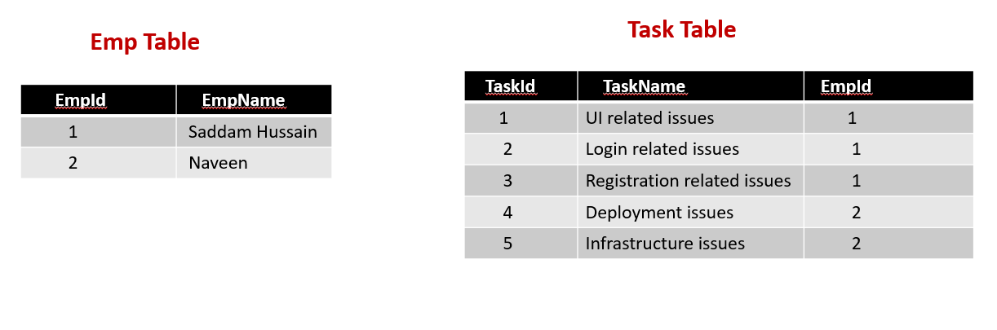
Many-To-One Bi-directional Mapping

Slide 136
Video link : https://youtu.be/dO9una6QqvY

Slide 137
Spring Boot Framework
Day 19

Slide 138
Many-to-Many Uni-directional
Mapping in Spring Boot

Slide 139
Customer Table
Item Table
Customer_Id | Customer_Name
1 | Saddam Hussain
4 | Naveen
6 | Sagar
Item_Id | Items
2 | Mobile
3 | Laptop
5 | Earphones
7 | Mouse
8 | Headset
Customer Item Table
Customer_Id | Item_Id
1 | 2
1 | 3
4 | 5
6 | 7
6 | 8

Slide 140
Video link : https://youtu.be/7AA7-h7oLlM

Slide 141
Spring Boot Framework
Day 20

Slide 142
Many-to-Many Bi-directional
Mapping in Spring Boot

Slide 143
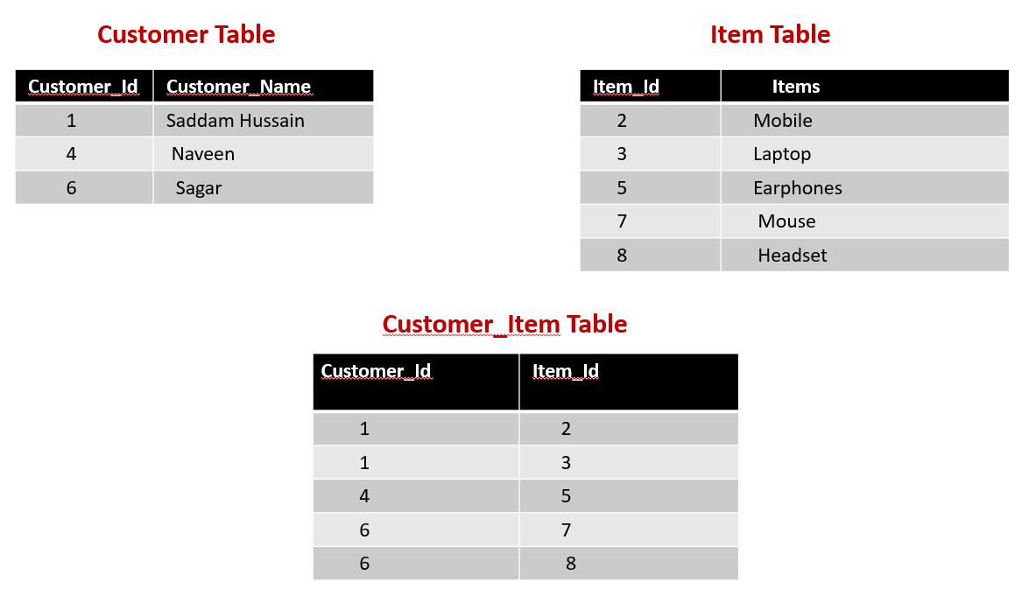

Slide 144
Video link : https://youtu.be/sus8Z7Nha7c

Slide 145
Spring Boot Framework
Day 21

Slide 146
Project Deployment Using Tomcat Server

Slide 147
Setting up a Spring Boot Application
Create a Spring Boot WAR
Deploy the WAR to Tomcat

Slide 148
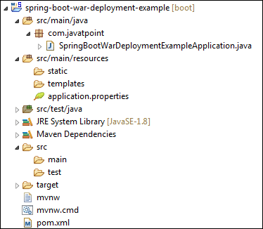
Setting up a Spring Boot Application

Slide 149
Create a Spring Boot WAR
Extends the SpringBootServletInitializer class in the main class.
Marked the embedded servlet container as provided.
Override the Configure method.
@Override
protected SpringApplicationBuilder configure(SpringApplicationBuilder application)
{
return application.sources(SpringBootWarDeploymentExampleApplication.class);
}

Slide 150
Update packaging JAR to WAR
Modify the final WAR file name by using the <finalName> tag to avoid including the version numbers.
We have created a WAR file with the name web-services.
<finalName>web-services</finalName>

Slide 151
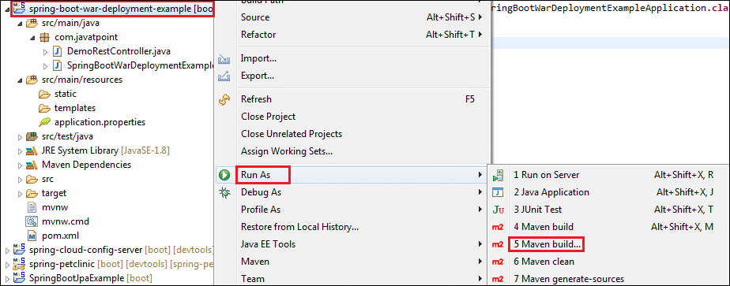
Create a WAR file by using the following steps:
Right-click on the project -> Run As -> 5 Maven Build

Slide 152
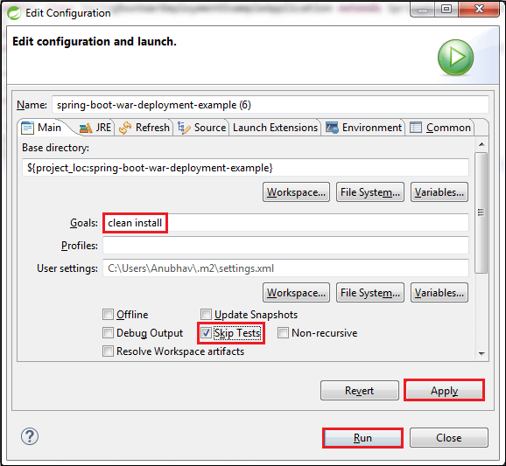

Slide 153
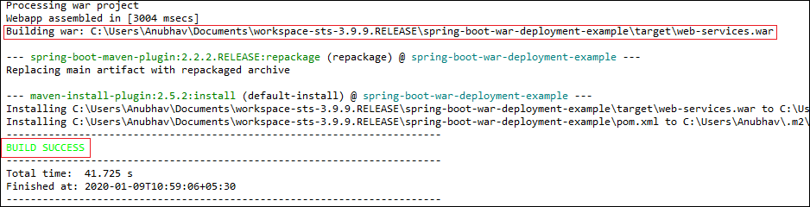
When the WAR file successfully created, it shows the WAR file path and a message BUILD SUCCESS in the console, as shown in the following figure.

Slide 154
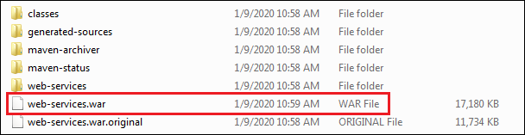
Copy the path and access the target folder of the application.
We found the WAR file inside the target folder with the same name as we have specified in the pom.xml file.

Slide 155
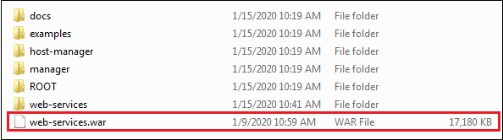
Deploy the WAR file to Tomcat
To deploy the WAR file, follow the steps below:
Download and install the Apache Tomcat Server, if not installed.
Copy the WAR file (web-services.war) and paste it inside the webapps folder of the Tomcat. In our case, the location of the webapps folder is:

Slide 156
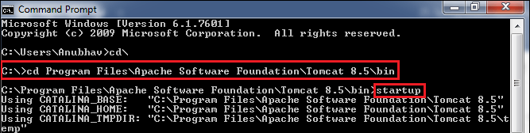
Now open the Command Prompt and type the following commands:
C:\Cd Program Files\Apache Software Foundation\Tomcat 8.5\bin
C:\Cd Program Files\Apache Software Foundation\Tomcat 8.5\bin>startup

Slide 157
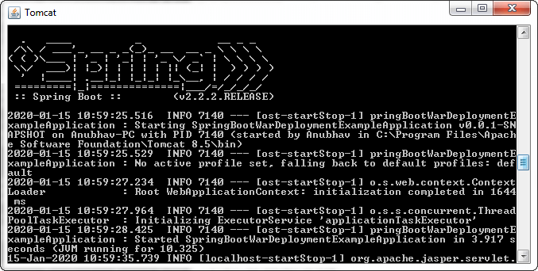


Slide 158
Open the browser and invoke the URL http://localhost:8080/web-services/hello.
It returns the message

